Slide 1
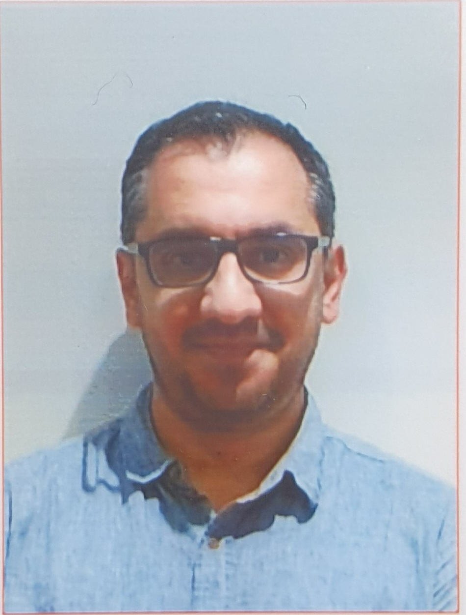
Introduction to Software Engineering (ISE102) Showcase Presentation

Slide 2
Showcase Presentation
Link to join online presentation 28th Oct 6:15 PM – 8:15 PM
Link to join online presentation 31st Oct 12 PM - 2PM
Face-to-Face presentation 4th Nov 4 PM – 6 PM with a link to join online if needed
Face-to-Face presentation 7th Nov 12 PM – 2PM with a link to join online if needed
Questions and Answers about Presentation

Slide 3
Link to join online presentation 28th Oct 6:15 PM – 8:15 PM
Here is the link for Tuesday 28th Oct 6:15 PM – 8:15 PM
Online Presentation FSD Tuesday 28th Oct (6:15 PM - 8:15 PM) | Meeting-Join | Microsoft Teams
https://teams.microsoft.com/l/meetup-join/19%3ameeting_YjkwYzFkYWUtZGU4OS00Y2FiLTkyNDEtZmQ3NjczMjBjOWVk%40thread.v2/0?context=%7b%22Tid%22%3a%22e8911c26-cf9f-4a9c-878e-527807be8791%22%2c%22Oid%22%3a%229506d58e-77d8-417d-a0ac-cbcbd8f071a2%22%7d

Slide 4
Link to join online presentation 31st Oct 12 PM - 2PM
Here is the link for Friday 31st Oct 12 PM – 2 PM
Online Presentation FSD Friday 31st Oct (12 PM - 2 PM) | Meeting-Join | Microsoft Teams
https://teams.microsoft.com/l/meetup-join/19%3ameeting_ODRlOTRmNjItNjlhYi00M2JlLTgxNWEtNzlkMjE4N2U4NTc3%40thread.v2/0?context=%7b%22Tid%22%3a%22e8911c26-cf9f-4a9c-878e-527807be8791%22%2c%22Oid%22%3a%229506d58e-77d8-417d-a0ac-cbcbd8f071a2%22%7d

Slide 5
Face-to-Face presentation 4th Nov 4 PM – 6 PM with a link to join online if needed
Tuesday 4th Nov 4 – 6 PM is face-to-face presentation at CB11.B1.403. However, if needed here is the link to join online
Tuesday 4th Nov 4 – 6 PM (Face-to-Face and Online) | Meeting-Join | Microsoft Teams
https://teams.microsoft.com/l/meetup-join/19%3ameeting_YWYwNWU5MjgtYzNhZS00NmJiLTljZWUtMGU5YmZmNmYwMDE4%40thread.v2/0?context=%7b%22Tid%22%3a%22e8911c26-cf9f-4a9c-878e-527807be8791%22%2c%22Oid%22%3a%229506d58e-77d8-417d-a0ac-cbcbd8f071a2%22%7d

Slide 6
Face-to-Face presentation 7th Nov 12 PM – 2 PM with a link to join online if needed
Friday 7th Nov 12 – 2 PM is face-to-face presentation at CB11.B1.401. However, if needed here is the link to join online
Friday 7th Nov 12 PM – 2 PM (Face-to-Face and Online) | Meeting-Join | Microsoft Teams
https://teams.microsoft.com/l/meetup-join/19%3ameeting_NzA2YTNhYWEtNDkxYy00ODg3LTg5ZjYtNTQ2NTU2YmRiNTNi%40thread.v2/0?context=%7b%22Tid%22%3a%22e8911c26-cf9f-4a9c-878e-527807be8791%22%2c%22Oid%22%3a%229506d58e-77d8-417d-a0ac-cbcbd8f071a2%22%7d

Slide 7
Questions and Answers
Dear Dr. Farshid Keivanian,
I hope this message finds you well.
I'm Masaki Taniguchi, a student in 32555 Fundamentals of Software Development (Tuesday 4 PM, Cmp1-01, Group 9)
As mentioned in the email subject, we have an issue with one of our group members.
One of our members does not write any code, and apparently, he does not understand any code the other members created. The code itself has been completed, as the other members covered for his part.
So, I want to clarify these two questions below:
What will happen if we mark someone 0% in a peer review(SparkPlus)?
In tomorrow's showcase, will all group members have to explain the code? If so, we doubt he can explain anything or answer any questions you may have.
Thank you very much for your time and consideration.
Kind regards, ….

Slide 8
Questions and Answers
Dear ….,
Thank you for reaching out and for your honesty in addressing this situation. I appreciate your team’s effort and responsibility in ensuring the project was completed to a high standard.
Regarding your questions:
Peer Review (SparkPlus): If you mark someone 0% in SparkPlus, it means you are indicating that the person did not contribute at all to the group task. The system will treat this as no participation, and SparkPlus will automatically adjust the contribution scores so that person’s grade is proportionally reduced, while others’ scores are scaled up if applicable.
However, before assigning 0%, please ensure this accurately reflects the group situation — SparkPlus responses are reviewed by the teaching team, and we may contact the group to verify if a member truly made no contribution.
It’s always best to use the comments section in SparkPlus to justify your score clearly (e.g., “did not attend meetings or contribute to work”).

Slide 9
Questions and Answers
Showcase Presentation: Yes, all group members are expected to briefly explain part of the code or demonstrate understanding of the system. This is to confirm that each student has contributed meaningfully and understands the project. If a student cannot answer basic questions about the code or their role, that will be reflected in their individual mark.
Please reassure your team that your proactive communication is appreciated — it helps maintain transparency and fairness for everyone.
Kind regards,
Dr. Farshid Keivanian

Slide 10
Questions and Answers
Dear Dr. Farshid Keivanian,
I hope this message finds you well.
I'm Jisu Kim, a student in 32555 Fundamentals of Software Development (Tuesday 4 PM, Cmp1-01, Group 9)
I have a few questions regarding the GUI implementation and sample output consistency in Assessment 1-Part 2 and 3. and I’m so sorry for sending this email over the weekend, and I truly appreciate your understanding.
Question 1: GUI Implementation
I’d like to clarify one point about the connection between the CLI and GUI parts in Assessment 1.
From the Week 10 lecture slides (from your github), my understanding is that the GUI should use the same data file (students.data) and the same Student objects as the CLI, ensuring consistent functionality between both versions. In other words, the CLI acts as the backend, and the GUI works as the frontend that interacts with it.
Could you please confirm whether this interpretation is correct, that the GUI should directly access and update the same students.data file (rather than working independently)?
That is to say, can I understand it as, when we execute the GUI file alone, it should import and run the CLI modules so that the GUI version performs the same functions as the CLI version, including the graphical interface?

Slide 11
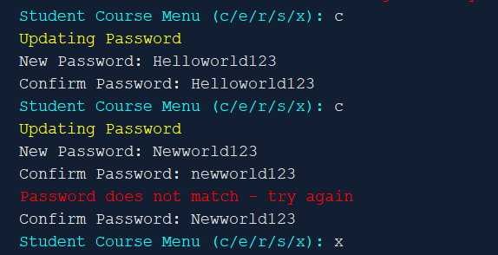
Questions and Answers
Question 2: consistency with sample output
e.g., In Change Password Section
In the sample output, there is no confirmation message after the password change. So, I added the confirmation message such as "Your password has been successfully changed.", after saving the new password to the database. Should I remove this line to make my output identical to the sample output?
Figure 1. Sample output of the guideline page 6.
Since the rubric includes the criterion “Matching I/O – I/O wording and indentation match the sample output”, I just wanted to confirm whether the output must be exactly the same as the sample.
Thank you very much for your time and clarification.
Kind regards,

Slide 12
Questions and Answers
Dear …,
Thank you for your detailed and thoughtful questions — I appreciate your careful review of the assessment materials and your professionalism in clarifying these points.
Question 1: GUI Implementation
Your understanding is absolutely correct.
The GUI should use the same data file (students.data) and the same backend logic (Student objects, controllers, and validation methods) as the CLI version. The goal is to maintain consistent functionality between both interfaces — the CLI serves as the backend logic layer, while the GUI acts as the frontend that interacts with it.
In practice, this means:
The GUI file imports and uses the same modules that the CLI does (e.g., student_controller, data_store, system_services, etc.).
Both versions read and update the same data file, ensuring persistent and synchronized data.
When running the GUI version, it should be able to operate independently, but its operations (e.g., register, change password, update data) should reflect correctly in the same students.data file used by the CLI.

Slide 13
Questions and Answers
In short — yes, your interpretation is correct:
The GUI should access and update the same file as the CLI, using the same backend logic to ensure identical functionality and consistent data behavior.
Question 2: Consistency with Sample Output
That’s an excellent and very professional question.
The “Matching I/O wording and indentation” criterion in the rubric focuses on alignment with the functional structure and clarity of output, not literal character-by-character replication.

Slide 14
Questions and Answers
Therefore:
You can include additional messages like
“Your password has been successfully changed.” if it enhances clarity and user experience, as long as it does not disrupt the program flow or misrepresent functionality.
You do not need to remove the confirmation line — it is perfectly acceptable and even encouraged for good UX practice, as it confirms successful state change to the user.

Slide 15
Questions and Answers
Only ensure that:
The logical order of I/O interactions (input–processing–output) matches the sample flow.
The structure (menu options, indentation, and line sequence) remains consistent with the example.
Summary
GUI Integration: Should use the same backend modules and data file (students.data) for consistency.
I/O Consistency: Maintain functional and structural alignment; small additions that improve clarity are acceptable.

Slide 16
Questions and Answers
Your attention to these details reflects strong software engineering practice — it’s exactly the level of thoughtfulness expected at this stage.
Also, please note that all presentation PowerPoints with their links (including Tuesday and Friday’s sessions) are now attached for your reference.
Kind regards,
Dr. Farshid Keivanian

Slide 17
Questions and Answers
Dear Dr. Farshid Keivanian,
Thank you so much for your detailed and kind response. Your explanation about the GUI and CLI integration clarified everything perfectly, and it was incredibly helpful for my team as we are preparing for next week’s presentation.
I truly appreciate the time and effort you took to reply so thoroughly, and also for letting us know the presentation schedule. Our group will attend and present during our regular tutorial time, and we will try our best to complete the assessment following your advice.
Thank you once again for your guidance and support.
Kind regards, …

Slide 18

Happy Learning and Bright Futures Ahead! Dr. Farshid Keivanian Stay Connected: linkedin.com/in/farshid-keivanian github.com/FarshidKeivanian
Education is the most powerful weapon you can use to change the world. — Nelson Mandela

